Slide 1
Foreign Exchange Environment
Dr. Kwangsoo Kim
Konkuk University

Slide 2
AGENDA
Foreign Exchange Market
Global Monetary System
Responses to FX Movements
Implications for Businesses

Slide 3
Foreign Exchange Market

Slide 4
Foreign Exchange Market
Market where individuals, firms, governments, and banks buy and sell foreign currencies
A global network of banks, brokers, and foreign exchange dealers connected by electronic communications systems
The market is always open somewhere in the world
(arbitrage - the process of buying a currency low and selling it high - is feasible)
Many transactions involve U.S. dollars on one side

Slide 5
Functions
The foreign exchange market:
Enables the conversion of the currency of one country into the currency of another
Provides some insurance against foreign exchange risk (exchange rate changes from the date of contract to the date of payment) - hedging

Slide 6
Currency Conversion
International firms use foreign exchange markets
To convert export receipts, income received from foreign
investments, or income received from licensing agreements
To pay a foreign company for products or services
To invest spare cash for short terms in money markets
for currency speculation (the short-term movement of funds
from one currency to another in the hopes of profiting from
shifts in exchange rates)
Average daily trading values:
$200 billion(1986); $1.2 trillion(1995); $1.8 trillion(2004); $3.2 trillion(2007) ; $4.0 trillion(2010); $5.5 trillion(2014); $7.5 trillion(April 2022)

Slide 7
Global Financial Centers
London: 34%
New York: 16%
Tokyo: 6%
Singapore: 6%
as of 2009
Amsterdam
Brussels
Hamburg
Dusseldorf
London
Frankfurt
Toronto
Paris
Zurich
Basel
Rome
San
Francisco
Chicago
Madrid
Vienna
New
York
Tokyo
Hong Kong
Mexico
City
Bombay
Singapore
Sydney
Rio de Janiero
São Paulo
Melbourne

Slide 8
Determinants/Theories of Exchange Rate Changes
Exchange Rate:
The rate at which one currency is converted into another
Basic Rule of Exchange Rate Determinants:
The demand and supply of one currency relative to the demand and supply of another
Three factors that have an important impact on future exchange rate movements are:
1) a country’s price inflation
2) a country’s interest rate
3) market psychology

Slide 9
Prices and Exchange Rates
The law of one price
In competitive markets free of transportation costs and trade barriers, identical products sold in different countries must sell for the same price when their price is expressed in terms of the same currency
Purchasing power parity(PPP)
- Given efficient markets, the price of identical products should be equivalent in each country.
- $10 in US and 10,000 won in Korea → EX rate: $1=1,000 won
PPP theory predicts that changes in relative prices will result in a change in exchange rates.
- $10 in US and 12,000 won in Korea → EX rate: $1=1,200 won
- Price inflation (an increase in money supply) in a country depreciates its currency by the same percentage.

Slide 10
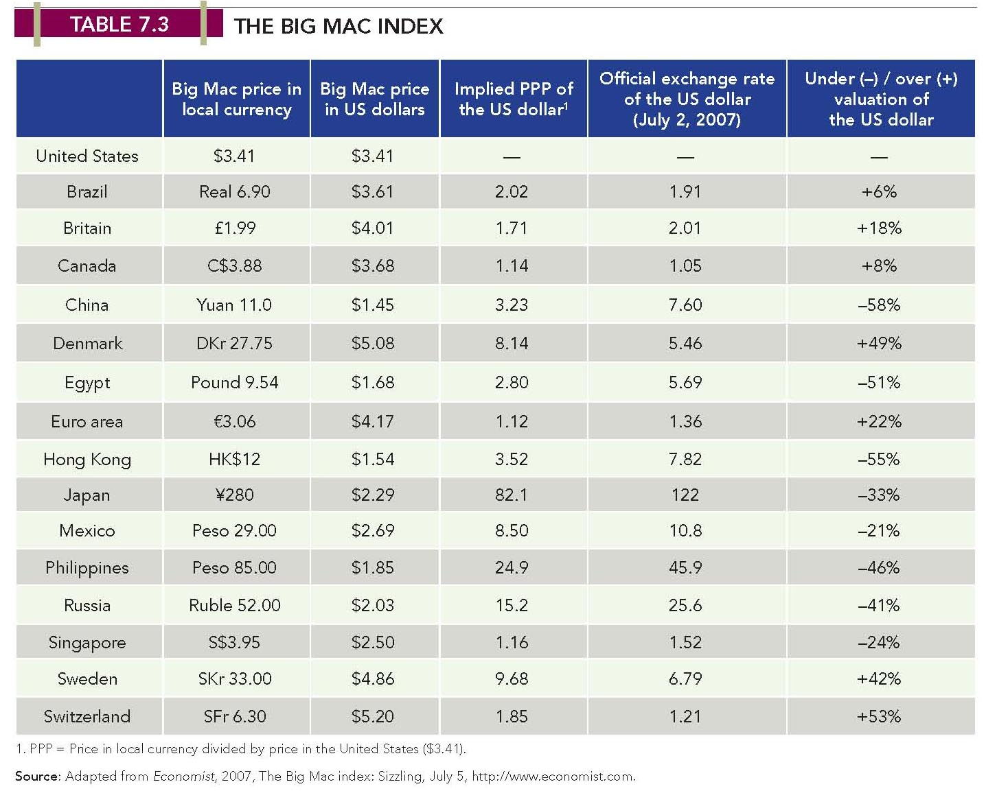
The Big Mac Index

Slide 11
Interest Rates and Exchange Rates
Fisher Effect: i = r + I
- (i): nominal interest rate; (r): real interest rate; (I): expected
inflation rate over the period for which the funds are to be lent
- Given efficient markets, any difference in interest rates between
countries reflects differing expectations about inflation rates
International Fisher Effect
- For any two countries, the spot exchange rate should change in
an equal amount but in the opposite direction to the difference
in nominal interest rates between the two countries
- For example, if i=5% in US and i=10% in Korea, the Korean
Won will depreciate by 5% over time

Slide 12
Investor Psychology and Exchange Rates
The bandwagon effect occurs when expectations on the part of traders turn into self-fulfilling prophecies, and traders join the bandwagon and move exchange rates based on group expectations
Governmental intervention can prevent the bandwagon from starting, but is not always effective
George Soros during the Asian economic crisis
Relative monetary growth, relative inflation rates, and nominal interest rate differentials are good predictors of long-run changes of exchange rates, and psychological factors, investor expectations and bandwagon effects are good predictors of short-run changes of exchange rates.

Slide 13
Currency Convertibility
Freely convertible
- Both residents and nonresidents are allowed to purchase unlimited amounts of a foreign currency.
Externally convertible
- Nonresidents can freely convert a local currency into a foreign currency, but residents are limited in doing so.
Nonconvertible
- Neither residents nor nonresidents are allowed to convert it into a foreign currency.
Countertrade
- The trade of goods and services produced in one country for those of another country

Slide 14
Global Monetary System

Slide 15
Global Monetary System
The global institutional arrangements that govern exchange rates
Evolution of the global monetary system
- The gold standard
- The Bretton Woods System
- The floating exchange rate System

Slide 16
Gold Standard
Inconvenient to ship gold coins for exports / imports
Pegging paper currencies to gold and guaranteeing convertibility at a fixed rate (1870 - 1914)
Strength: Achieve balance-of-trade equilibrium:
Excess export - gold inflow – money supply – inflation (more expensive) – reduced export
Key assumption: Money supply based on gold in each nation
Failed during the period of the two world wars:
Money supply not based on gold – Countries suspended convertibility and devalued currencies competitively (Britain, US, German, and others)

Slide 17
Bretton Woods System
Fixed exchange rate system adopted in 1944 (1944 – 1973)
Peg individual currencies to $US which only was convertible to gold at $35/oz
Each country agreed not to engage in competitive devaluations and to defend their currencies
Created the IMF and the world bank
- IMF: Lend money to members short-term to adjust their BOP position and maintain their exchange rates
- WB: Promote general economic development
Key assumption: US money supply based on gold
In 1973, the system collapsed – too much supply of $US (Vietnam War and welfare) / US inflation & trade deficit - downward pressure on $US – US stopped converting $US into gold

Slide 18
Floating Exchange Rate System
The Jamaica Agreement:
- A floating exchange rate regime was setup in 1976.
The rules for the global monetary system that were agreed upon at the meeting are still in place today
Under the Jamaican agreement,
- floating rates were declared acceptable
- gold was abandoned as a reserve asset
The exchange rate is determined primarily by supply/demand
Since 1973, exchange rates have been floating and much more volatile and less predictable
- Asian currency crisis, recent financial crisis, etc.

Slide 19
Fixed vs. Floating: Pros
Floating:
- Monetary policy autonomy
- Trade balance adjustments
Fixed:
- Monetary discipline
- Speculation
- Uncertainty

Slide 20
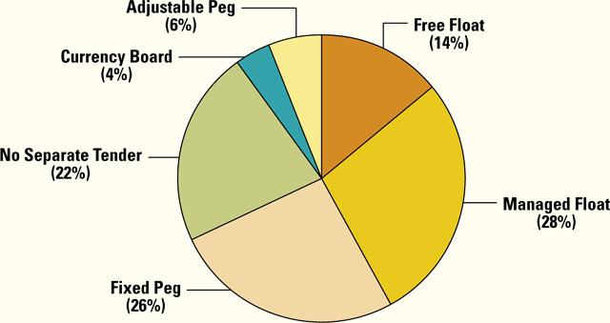
Current Exchange Rate Regimes
Exchange Rate Policies, IMF Members, 2006

Slide 21
Responses To
Foreign Exchange Movements

Slide 22
Foreign Exchange Risk Exposure
Transaction exposure:
Degree to which the income from individual transactions is influenced by changes in exchange rates. This can lead to a real monetary loss
Translation exposure:
Effect of changes in exchange rates on the reported financial statements of a company. Gains and losses from translation exposure are reflected only on paper
Economic exposure:
Extent to which a firm’s future international earning power is influenced by exchange rate changes. This is related with the long-term effect of exchange rate changes on future prices, sales, and costs (competitive position)

Slide 23
Managing Transaction Risks
Hedging through foreign exchange market contracts
- Forward contact (forward exchange rates) - two parties agree to exchange currency and execute the deal at some specific future date and exchange rate.
- Futures contract (futures exchange rates) – Organized markets for trading contracts for the future delivery of currency at a specific date and exchange rate.
- Options – contract to buy the right to buy(call) or to sell(put) currency at a specific date and exchange rate.
Hedging through money market loans - Spot market conversion of loaned funds (spot exchange rate)
Leading and lagging - the timing of cash exchanges
Invoicing currency: bill customers in a currency other than their local currency (customers and suppliers in different nations)
Currency swap - the simultaneous purchase and sale of a given amount of foreign exchange for two different value dates at some specified exchange rate.

Slide 24
Managing Translation/Economic Risks
Balance sheet adjustments
- involves maintaining a net zero exposure (or a net asset or liability exposure) through the management of account balances
Licensing/outsourcing
- Licensing its product to an independent foreign company - Licensing eliminates all translation exposure since there is no foreign affiliate to consolidate
Distribution of firms’ productive assets to various locations worldwide
- This way firms’ long-run financial well-being is not severely affected by adverse exchange rate changes

Slide 25
Implications for Businesses

Slide 26
Implications for Businesses
Firms need to understand the importance of foreign exchange environment for business operations
Firms should be aware of the forces that influence exchange rates – prices, inflation rate, interest rate, investor psychology, productivity, balance of payments, etc.
Firms also need to understand the influence of exchange rate changes on the profitability of trade and investment.
Firms need to understand foreign exchange risks (transaction, translation, economic exposure) and risk management (spot market, forward contract, futures contract, leading & lagging, etc.)

Slide 27
Implications for Business
Firms need to understand that government intervention, along with economic reasons, can drive the foreign exchange market.
The foreign exchange market does not always provide flexibility (currency convertibility) necessary to make international trade and investment possible.
Firms can influence government policy towards the international monetary system. Firms should focus their efforts on encouraging the government to:
- promote the growth of international trade and investment
- adopt an international monetary system that minimizes volatile exchange rates

Slide 28
Implications for Business
Firms need to pursue strategies that will increase strategic flexibility in the face of unpredictable exchange rate movements:
- Dispersing production around the globe for hedging
- Contracting out manufacturing activities – shift suppliers
All these factors eventually promote globalization.

